Slide 1
Musilarity
Web Analytics 2024
Amaia Diego Francisco Alejandro

Slide 2
Context
Music tastes are highly personal and keeps varying constantly
There are several preferences of music around the world
We often discover new songs through shared social experiences
Spotify Wrapped has become a cultural phenomenon.
Connect People

Slide 3

Project Goal
Similarity index by musical preferences.
Personalized insights comparing your tastes with others.

Slide 4
What will be based on?
Genres
Artists
Countries
People

Slide 5

Data
Source

Slide 6
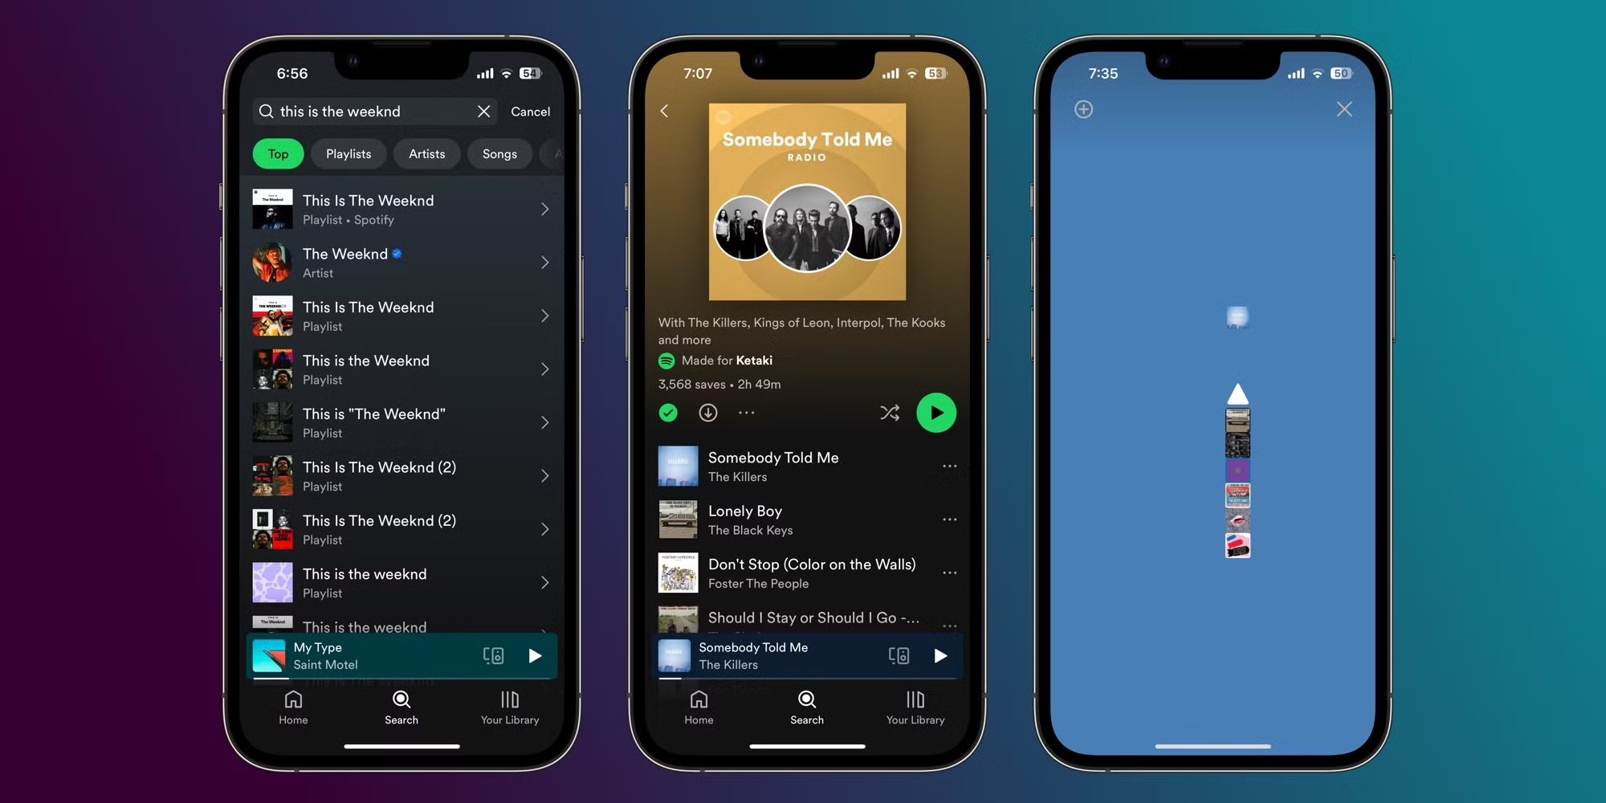



Spotify Web API

Slide 7
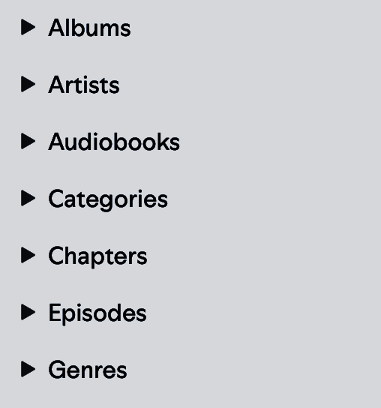
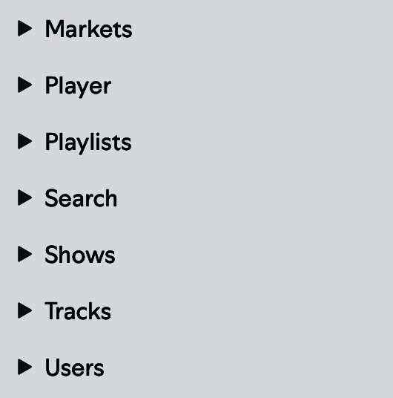

Spotify Web API

Slide 8
Planed Analysis

Slide 9
Graph theory & Network analysis

Slide 10







Users : type 1 nodes Items : type 2 nodes
User - item : top items
item - item : tuned value
Give weights
Create conceptually user - user: “similarity index”

Slide 11
Content-based filtering
Graph embeddings

Slide 12
Users profile as features vectors / graph embeddings
Vector space
Similarity
Cosine

Slide 13
Clustering

Slide 14
Users features data
Clustering algorithms
K-means, DBSCAN
Grouping

Slide 15
Collaborative filtering

Slide 16
User-item interaction matrix
Matrix factorization
SVD, ALS
Similarity

Slide 17
State of
the Art

Slide 18



Other works:
Similarity index with other users
Similarity index by location
Real time insights

Slide 19

THANK YOU!

